Slide 1
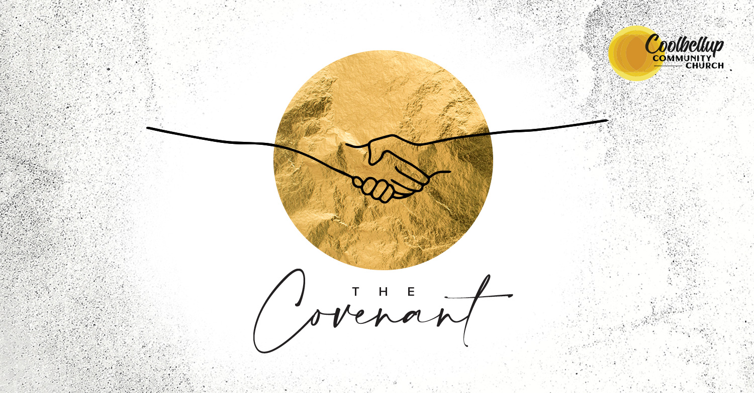
The Abrahamic Covenant
Michael Christie

Slide 2
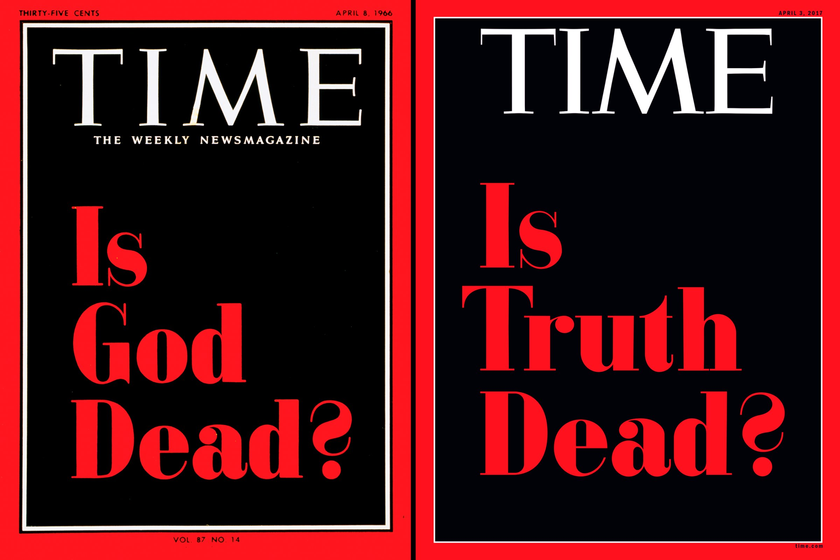
https://time.com/4709920/donald-trump-truth-time-cover/

Slide 4
I became a devout follower of one true religion of the 21st century: uncertainty… There’s nothing comforting about being agnostic… I started to wonder if it was time to find God. Definite God, that is. Not the half-hearted agnostic one built on a Jenga tower of uncertainty… the spiritual equivalent of the shrug emoji.
- ELEANOR MARGOLIS

Slide 5
So this is what the Sovereign Lord says: “See, I lay a stone in Zion, a tested stone, a precious cornerstone for a sure foundation; the one who relies on it will never be stricken with panic.
- ISAIAH 28:16

Slide 6
GENESIS 15:1-18
¹ After this, the word of the Lord came to Abram in a vision: “Do not be afraid, Abram. I am your shield, your very great reward.” ² But Abram said, “Sovereign LORD, what can you give me since I remain childless and the one who will inherit my estate is Eliezer of Damascus?”

Slide 7
³ And Abram said, “You have given me no children; so a servant in my household will be my heir.” ⁴ Then the word of the Lord came to him: “This man will not be your heir, but a son who is your own flesh and blood will be your heir.” ⁵ He took him outside and said, “Look up at the sky and count the stars—if indeed you can count them.” Then he said to him, “So shall your offspring be.”

Slide 8
⁶ Abram believed the Lord, and he credited it to him as righteousness.
⁷ He also said to him, “I am the Lord, who brought you out of Ur of the Chaldeans to give you this land to take possession of it.”
⁸ But Abram said, “Sovereign Lord, how can I know that I will gain possession of it?”

Slide 9
⁹ So the Lord said to him, “Bring me a heifer, a goat and a ram, each three years old, along with a dove and a young pigeon.” ¹⁰ Abram brought all these to him, cut them in two and arranged the halves opposite each other; the birds, however, he did not cut in half. ¹¹ Then birds of prey came down on the carcasses, but Abram drove them away.

Slide 10
¹² As the sun was setting, Abram fell into a deep sleep, and a thick and dreadful darkness came over him. ¹³ Then the Lord said to him, “Know for certain that for four hundred years your descendants will be strangers in a country not their own and that they will be enslaved and mistreated there.

Slide 11
¹⁴ But I will punish the nation they serve as slaves, and afterward they will come out with great possessions. ¹⁵ You, however, will go to your ancestors in peace and be buried at a good old age. ¹⁶ In the fourth generation your descendants will come back here, for the sin of the Amorites has not yet reached its full measure.”

Slide 12
¹⁷ When the sun had set and darkness had fallen, a smoking firepot with a blazing torch appeared and passed between the pieces.
¹⁸ On that day the Lord made a covenant with Abram and said, “To your descendants I give this land…”

Slide 14
Covenant RECEIVED
The Lord had said to Abram, “Go from your country, your people and your father’s household to the land I will show you. “I will make you into a great nation, and I will bless you; I will make your name great, and you will be a blessing… and all peoples on earth will be blessed through you.”
- GENESIS 12:1-3

Slide 15
“Anyone who loves their father or mother more than me is not worthy of me; anyone who loves their son or daughter more than me is not worthy of me. Whoever does not take up their cross and follow me is not worthy of me. Whoever finds their life will lose it, and whoever loses their life for my sake will find it.”
- MATTHEW 10:37-39

Slide 16
[Cheap grace is] forgiveness without requiring repentance, baptism without church discipline, communion without confession, absolution without confession personal confession… without discipleship, grace without the cross, grace without Jesus Christ, living and incarnate.
DIETRICH BONHOEFFER
The Cost of Discipleship

Slide 17
[Costly] grace is costly because it calls us to follow, and it is grace because it calls us to follow Jesus Christ. It is costly because it costs a man his life, and it is grace because it gives a man the only true life. It is costly because it condemns sin, and grace because it justifies the sinner. Above all, it is costly because it cost God the life of his Son… it is grace because God did not reckon his Son too dear a price to pay for our life, but delivered him up for us.
DIETRICH BONHOEFFER
The Cost of Discipleship

Slide 18
They will be my people, and I will be their God. I will give them singleness of heart and action, so that they will always fear me and that all will then go well for them... I will never stop doing good to them… I will rejoice in doing them good… with all my heart and soul.
- JEREMIAH 32:38-41

Slide 19
Tarry at the promise, and God will meet you there. He always returns by way of His promises.
- PURITANS

Slide 20
For no matter how many promises God has made, they are “Yes” in Christ. And so through him the “Amen” is spoken by us to the glory of God. Now it is God who makes both us and you stand firm in Christ. He anointed us, set his seal of ownership on us, and put his Spirit in our hearts as a deposit, guaranteeing what is to come.
- 2 CORINTHIANS 1:20-22

Slide 21
Covenant RATIFIED
Abram said, “Sovereign Lord, how can I know that I will gain possession of it? So the Lord said to him, “Bring me a heifer, a goat and a ram, each three years old, along with a dove and a young pigeon.” Abram brought all these to him, cut them in two and arranged the halves opposite each other.
- GENESIS 15:8-10

Slide 23
When the sun had set and darkness had fallen, a smoking firepot with a blazing torch appeared and passed between the pieces. On that day the Lord made a covenant with Abram and said, “To your descendants I give this land…”
- GENESIS 15:17-18

Slide 24
When God made his promise to Abraham, since there was no one greater for him to swear by, he swore by himself… God did this so that, by two unchangeable things in which it is impossible for God to lie, we who have fled to take hold of the hope set before us may be greatly encouraged. We have this hope as a firm anchor for the soul, firm and secure.
- HEBREWS 6:13, 18-19

Slide 25
Christ redeemed us from the curse of the law by becoming a curse for us… He redeemed us in order that the blessing given to Abraham might come to the Gentiles through Christ Jesus, so that by faith we might receive the promise of the Spirit.
- GALATIANS 3:13-14

Slide 26
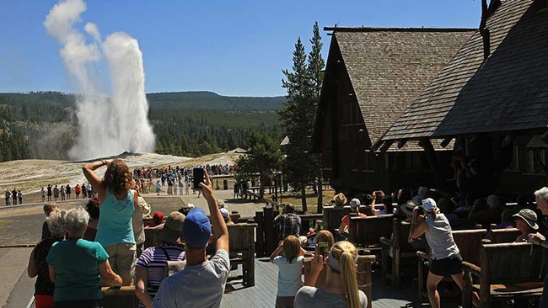
NPS/Jim Peaco; https://www.nps.gov/yell/planyourvisit/exploreoldfaithful.htm

Slide 27
Covenant RESULT
This is my covenant with you and your descendants after you, the covenant you are to keep: Every male among you shall be circumcised. You are to undergo circumcision, and it will be the sign of the covenant between me and you.
- GENESIS 17:10-11

Slide 28
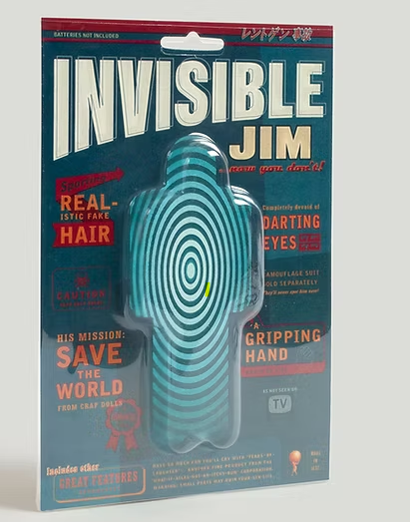
https://www.elsewheretrading.co/product-page/invisible-jim

Slide 29
In him you were also circumcised with a circumcision not performed by human hands. Your whole self ruled by the flesh was put off when you were circumcised by Christ.
- COLOSSIANS 2:11

Slide 30
Before we can be effective promise keepers, we must become promise receivers. The Bible is clear about God's promise: the One who has given us his life will be the One who lives it for us. Only Jesus Christ can effectively live the perfect life. He lives inside believers today and wants to reveal His perfect life through us.
- STEVE MCVEY

